Slide 1
DATA STRUCTURES & ALGORITHMS WITH JAVA
Lesson 02: Performance Optimization

Slide 2
Discussion
• Share your experience or knowledge about performance issues you have faced with in coding or running the applications. • The symptoms of performance issues? • How to avoid performance issues?

Slide 3
Lesson Objectives
▪ Overview of performance issue ▪ Performance optimization strategies – general guidelines ▪ Reduce time consumption ▪ Reduce space consumption

Slide 4


Introduction
• Performance issues plays an important role in software development. • They are caused by many factors during coding process
Notes:
Trong Java việc tối ưu hoá mã nguồn Java là công việc rất quan trọng, nó không chỉ giúp mã nguồn thông thoáng hơn, giúp tiêu tốn ít tài nguyên hệ thống hơn, mà các kĩ thuật được trình bày dưới đây sẽ giúp nâng cao hiệu suất (performance) làm việc của Java khi chạy chương trình!
Một LTV Java có kinh nghiệm luôn coi việc tối ưu hoá mã nguồn như là 1 phần quan trọng của công việc lập trình, trang bị những kĩ thuật, thủ thuật tối ưu sẽ thể hiện một LTV có trình độ, và coi nó như 1 kĩ năng không thể thiếu khi làm việc với Java.
Các kĩ thuật dưới đây không phải là những giải thuật toán học cao siêu, cũng không phải triển khai 1 cách phức tạp, đôi khi chúng rất dễ để thực hiện nhưng rất nhiều LTV không để ý hoặc chưa biết cách để triển khai nó.

Slide 5


Performance Issue Factors
• Poor design • Issues in coding • Technology issues • Applies of DSA • Applies of design patterns
Notes:
5 nguyên tắc này là làm cho code trở nên dễ hiểu, dễ bảo trì hơn và dễ mở rộng hơn. Là một software developer, 5 nguyên tắc này rất cần thiết!
https://viblo.asia/p/solid-principles-la-gi-Do754kDVlM6

Slide 6
Performance Optimization
• The code optimization in the synthesis phase is a program transformation technique used to improve the intermediate code by making it consume fewer resources.

Slide 7


Strategies for Optimization
▪ Reduce time consumption ▪ Reduce space consumption

Slide 8
Reduce Time Consumption
Section 1

Slide 9
Content
1. Standard code optimizations 2. Using fields and variables 3. Mutable or immutable 4. Storing tables of constants in arrays 5. Sorting and searching strategies 6. Exception Handling 7. Choose collection classes 8. Input and output (IO) 9. Space and object creation

Slide 10
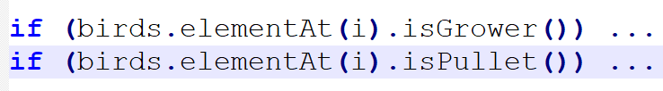
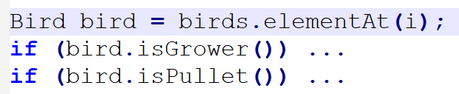
1. Standard Code Optimization (1)
• Move loop-invariant computations out of loops .
• Do not compute the same subexpression twice.

Slide 11
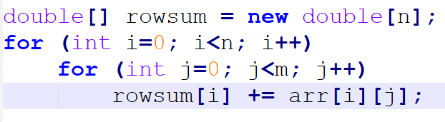
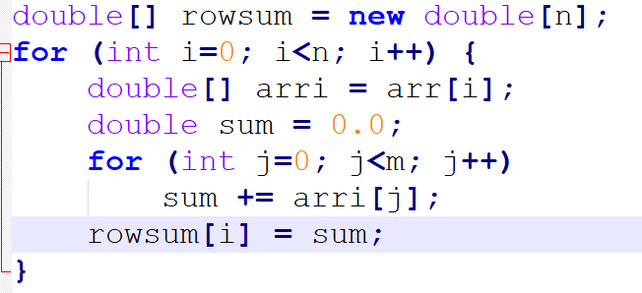
1. Standard Code Optimization (2)
• Reduce the number of array accesses

Slide 12
1. Standard Code Optimization (2)
• Declare constant fields as final static so that the compiler can inline them and precompute constant expressions. • Declare constant variables as final so that the compiler can inline them and precompute constant expressions. • Replace a long if-else-if chain by a switch if possible; this is much faster.

Slide 13
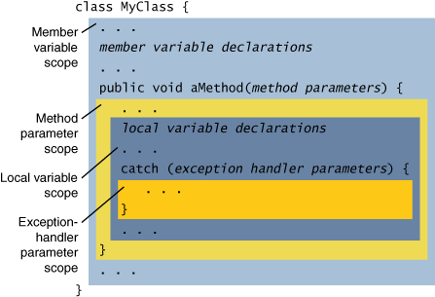
2. Using fields & variables
• Access to local variables and parameters in a method is much faster than access to static or instance fields. • Use small scope as much as possible.
Notes:
https://itecnote.com/tecnote/java-is-it-faster-to-access-final-local-variables-than-class-variables-in-java/

Slide 14

Variable Scopes - Discussion
• How many scopes? • Best practices when using variable scopes? • Common mistakes needed to avoid?
Notes:
There are three main types of variable scope in Java: Local scope. Instance scope. Static scope.
Keep scope as narrow as possible. We'll get into some detail further on, but this should be the key message. If you start with a restricted scope, it's easier to open things up later. It isn't so easy to un-bake the bread once you've exposed a variable to the world.

Slide 15
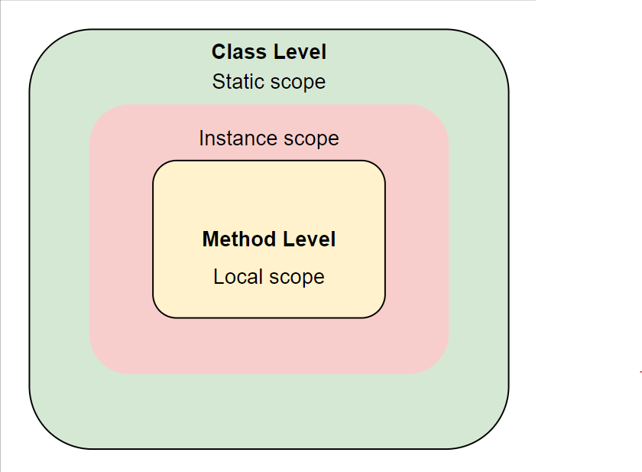
The scope of a variable in Java
Local scope
Instance scope
Static scope
Notes:
The scope of a variable refers to the portion of a program where the variable can be accessed. The scope of a variable can be determined by its location in the source code, as well as by any blocks of code (such as loops or conditional statements) that enclose it.
The above illustration explains the three types of scope we mentioned above and is the visual point of view of the variable scope. Let’s move forward with the variable scope and get a better understanding through explanation and code.

Slide 16
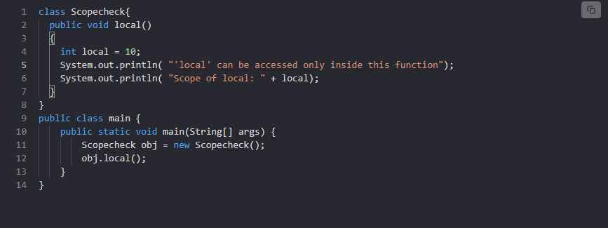
Local scope
Notes:
This refers to variables that are defined within a method or block of code. These variables are only accessible within the method or block where they were declared, and they are not visible to any code outside of that scope.
Explanation
Line 1-8: We created class named Scopecheck and it contains a single method, local().
Line 4: We declare an integer variable named local and assigns it the value of 10.
Line 5-6: We used the method System.out.println() to print two messages to the console.
Line 9-14: We created class named main class and contains a main method, and this is the entry point of the program.
Line 11: We created an object named obj of the Scopecheck class inside the main method.
Line 12: We called local() method of the object.

Slide 17
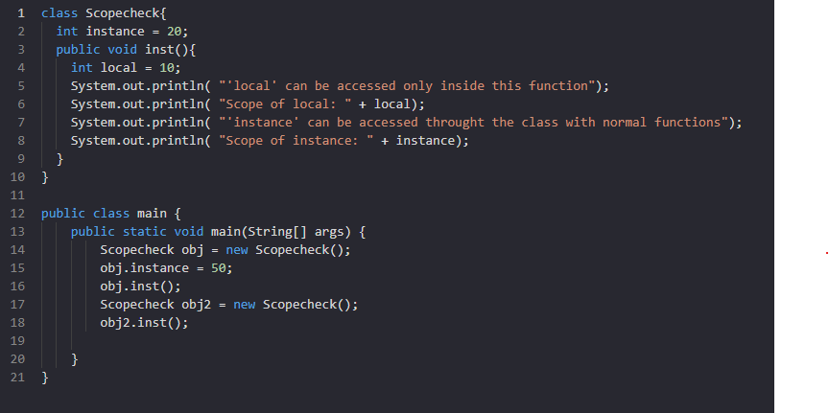
Instance scope
Notes:
This refers to variables that are defined as fields of a class (also known as instance variables). These variables are accessible within the entire class, including any methods, constructors, and nested classes.
In the program above:
We call the instance variable and from lines 14-18.
When we call an instance variable for the first time, its value changes.
When another call is made at line 17, its value returns to the previous one as it can be changed only for one instance.

Slide 18
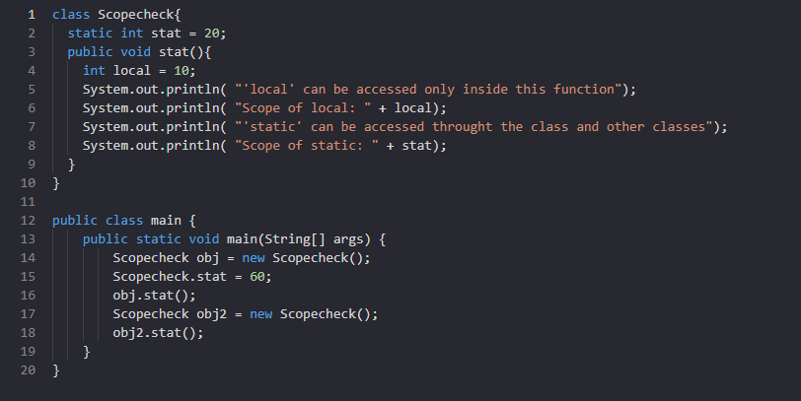
Static scope
Notes:
This refers to variables that are defined as static fields of a class. These variables are also accessible within the entire class, including any methods, constructors, and nested classes. Although they are shared among all instances of the class; these variables are accessible from anywhere in the code, even outside the class.
In the program above:
The value of the static variable, unlike the instance variable, changes for all the instances.
Lines 16 and 18 return the same value of the static variable as it will remain the same until we change it.

Slide 19

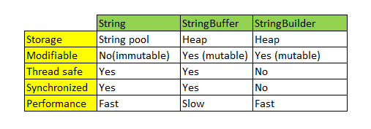
3. Mutable or immutable
• Choose mutable or immutable objects for the appropriate situations.
Notes:
Có thể khi đọc tiêu đề bài viết này, nhiều bạn bỡ ngỡ, giật mình vì đây là lần đầu tiên bạn gặp những từ ngữ và những khái niệm như này.
Mutable và Immutable Objects không phải là 1 khái niệm mới hay 1 kỹ thuật lập trình OOP gì đó cao siêu cả. Nó hoàn toàn cơ bản, và mọi người gọi chúng là Mutable Objects hay Immutable Objects để làm rõ đặc điểm cũng như tính năng của đối tượng đó có những gì và không có những gì.
Mutable và Immutable Objects khá gần gũi và quen thuộc với bạn trong quá trình bạn viết các chương trình Java hay OOP nói chung.
Vậy Mutable (trạng thái - thay đổi được) và Immutable (trạng thái - không thay đổi được) Objects là gì?
Đơn thuần, các đối tượng dạng Mutable và Immutable đều là những Class mà bạn tạo ra hay những Class dạng này được cung cấp sẵn trong Java. Nhưng để phân biệt các đối tượng Mutable và Immutable không phải dựa vào tên Class, hay tính thừa kế hoặc những cấu trúc đối tượng phức tạp mà dựa vào đặc điểm cũng như hành vi của đối tượng đó bằng các cặp phương thức Getter/Setter.
Tóm lược lại, tôi rút ra những khái niệm về Mutable và Immutable Object như sau:
Mutable Object: khi khởi tạo 1 đối tượng, tức ta có 1 tham chiếu tới 1 thể hiện của 1 lớp, thì trạng thái của đối tượng có thể thay đổi được sau khi việc khởi tạo đối tượng thành công. (Trạng thái đối tượng ở đây có thể là các trường thông tin mà đối tượng đó nắm giữ. Ví dụ: tên, tuổi của 1 đối tượng sinh viên chẳng hạn)
Immutable Object: khi khởi tạo 1 đối tượng, thì trạng thái của tối tượng đó không thể thay đổi được sau khi việc khởi tạo đối tượng thành công. (Điều này có nghĩa là, bạn chỉ có thể get mà không thể set).

Slide 20
Mutable vs Immutable - Discussion
• Pros and cons of mutable and immutable object? • String manipulation in Java • String pool • StringBuilder, StringBuffer? • When do we need thread-safe? • How to create immutable object?
Notes:
https://viblo.asia/p/mutable-va-immutable-objects-la-gi-qzaGzLALkyO

Slide 21
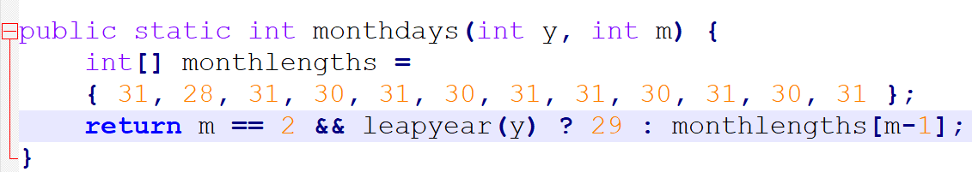
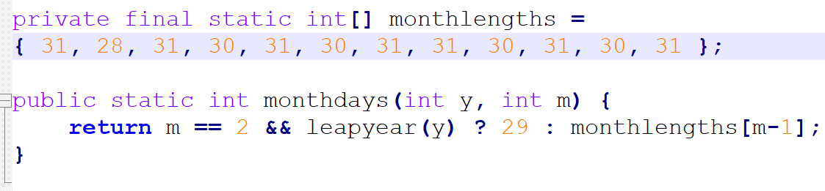
4. Constants in an array
• Declaring an initialized array variable inside a method causes a new array to be allocated at every execution of the method:

Slide 22

Constants in an Array
• Use static block when necessary. When and why?
Notes:
In a Java class, a static block is a set of instructions that is run only once when a class is loaded into memory. A static block is also called a static initialization block. This is because it is an option for initializing or setting up the class at run-time. The keyword 'static' indicates that it spans all instances of the class. It is like a mini-global set of instructions.
Let's take a look at how to declare a class and a static block.
public class SvC {
static {
//static block
System.out.println("Hi, I'm a Static Block!");
}
}

Slide 23
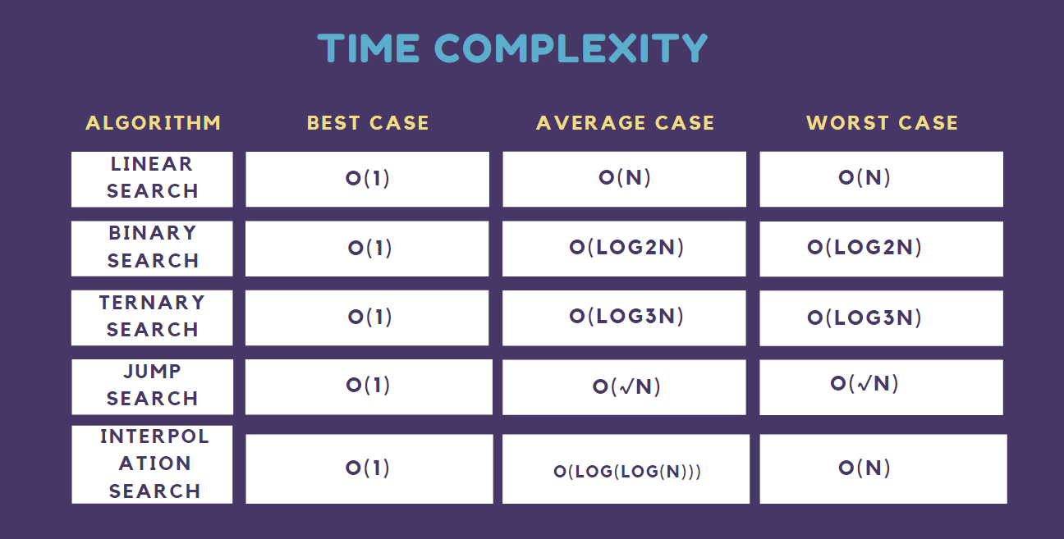
5. Sorting & Searching
• Choose the right sorting and searching algorithms. • Choose APIs for sorting and searching.

Slide 24
6. Exception Handling
• Consider creating new exception or using try catch block. • Should create an exception object only if you actually intend to throw it. • Do not use exceptions to implement control flow. • If your program does need to throw exceptions very frequently, reuse a single pre-created exception object.
Notes:
https://www.w3schools.com/java/java_try_catch.asp

Slide 25
7. Choose Collection Classes
• Consider using: ✓HashSet, HashMap ✓TreeSet, TreeMap ✓ArrayList, LinkedList • Consider using iterator to traverse a collection. • Avoid the legacy collection classes like Vector, Hashtable, Stack.

Slide 26
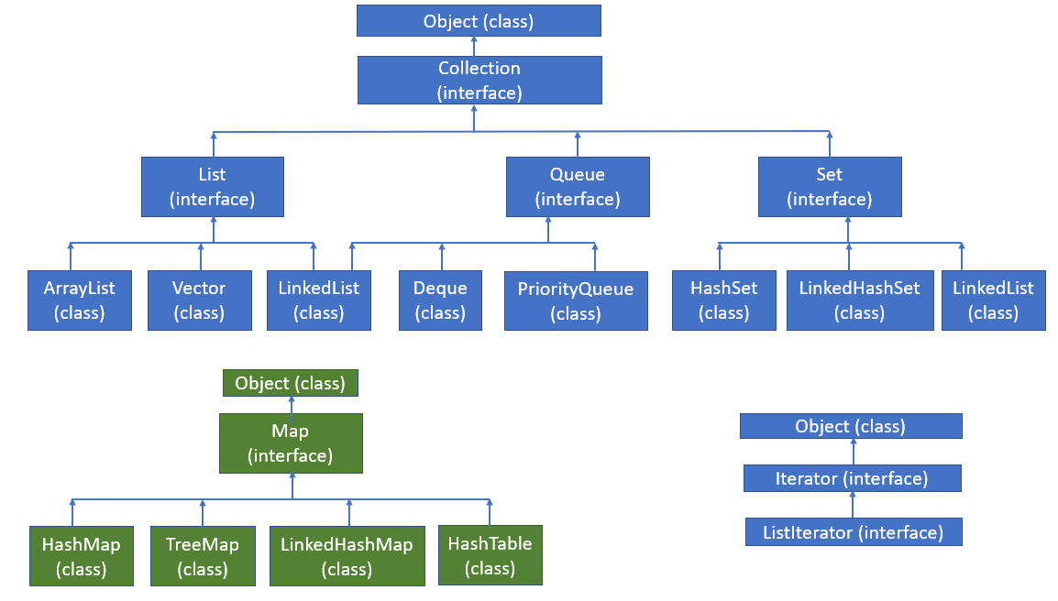
Java Collection Framework

Slide 27
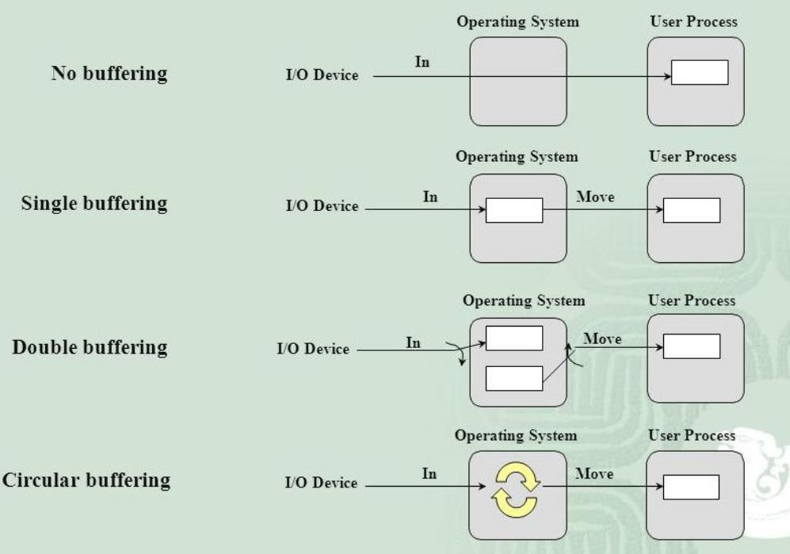
8. Input & Output
• Consider using buffered input and output.

Slide 28
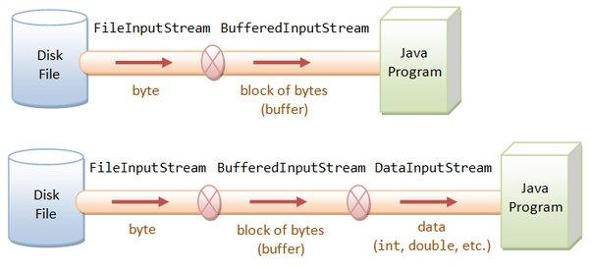
8. Input & Output

Slide 29
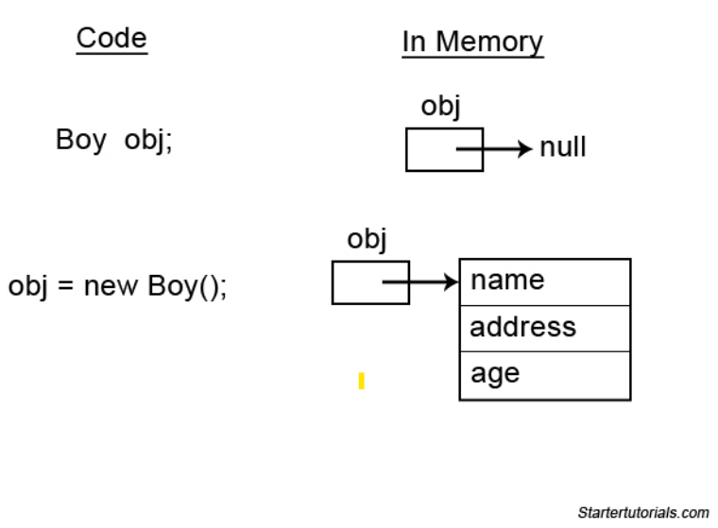
9. Space & Object Creation
• Object creation process: ✓Allocation ✓Initialization ✓Garbage collection • Do not create objects that are never used. • Do not create redundant object. • Release resources when not use.
Notes:
https://viblo.asia/p/garbage-collection-quan-ly-bo-nho-heap-trong-jvm-wjAM7aJrvmWe

Slide 30
Reduce Space Consumption
Section 2

Slide 31
Content
• Stack and Heap • Aspects of space usage • Space leak

Slide 32
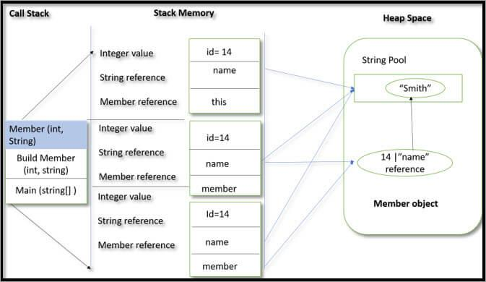
Stack and Heap
Notes:
https://viblo.asia/p/tim-hieu-ve-bo-nho-stack-vs-heap-trong-java-3P0lPaEb5ox
Bộ nhớ stack là một phần của bộ nhớ chứa mehtod, local variable và variable tham chiếu.Bộ nhớ stack luôn được tham chiếu theo last in first out. Local variable thi được tạo trong stack.
Bộ nhớ Heap là phần bộ nhớ chưa các Object cũng có thể chưa biến tham chiếu, instance variable được tạo ở đây.

Slide 33
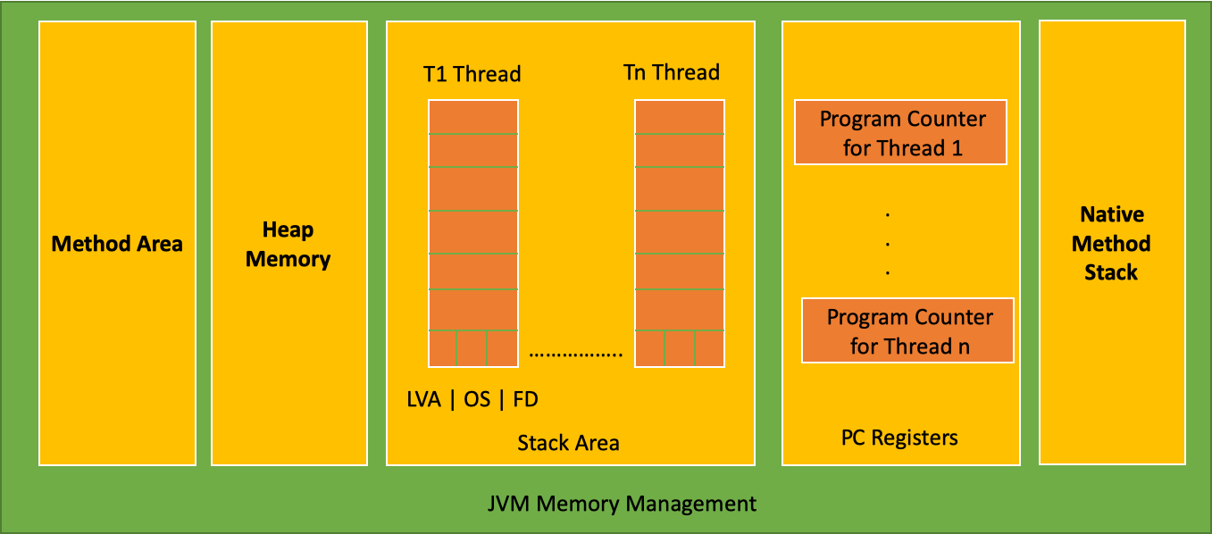
Aspects of Space Usage
• Allocation rate • Retention • Fragmentation

Slide 34
Space Leak
• A space leak is unwanted or unexpected retention, which usually causes memory consumption to grow linearly with execution time. • A space leak may be caused by a deeply tail-recursive method that should have been written as a loop. • Space leaks are caused by mistakes in your program. ✓Be careful when using static variable ✓Be careful when creating new objects… ✓Optimize frontend and backend parts

Slide 35
Array
Section 3

Slide 36
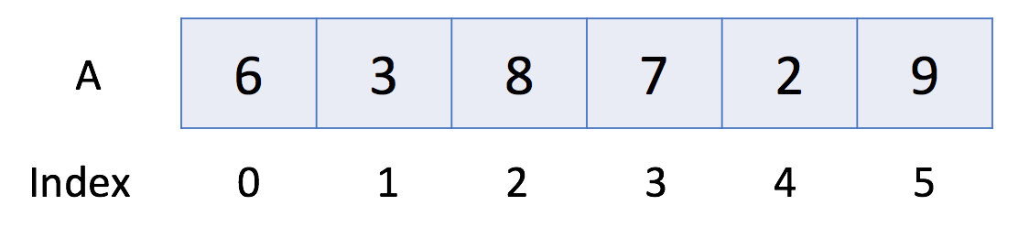
Introduction to Array
An array is a basic data structure to store a collection of elements sequentially. But elements can be accessed randomly since each element in the array can be identified by an array index.
An array can have one or more dimensions. Here we start with the one-dimensional array, which is also called the linear array.
Notes:
In the above example, there are 6 elements in array A. That is to say, the length of A is 6.
We can use A[0] to represent the first element in the array.
Therefore, A[0] = 6. Similarly, A[1] = 3, A[2] = 8 and so on.

Slide 37
Find Pivot Index
Given an array of integers nums, calculate the pivot index of this array.
The pivot index is the index where the sum of all the numbers strictly to the left of the index is equal to the sum of all the numbers strictly to the index's right.
If the index is on the left edge of the array, then the left sum is 0 because there are no elements to the left. This also applies to the right edge of the array.
Return the leftmost pivot index. If no such index exists, return -1.

Slide 38
Find Pivot Index
Constraints:
1 <= nums.length <= 104
-1000 <= nums[i] <= 1000

Slide 39
Find Pivot Index
Example 1:
Input: nums = [1,7,3,6,5,6]
Output: 3
Explanation:
The pivot index is 3.
Left sum = nums[0] + nums[1] + nums[2] = 1 + 7 + 3 = 11
Right sum = nums[4] + nums[5] = 5 + 6 = 11

Slide 40
Find Pivot Index
Example 2:
Input: nums = [1,2,3]
Output: -1
Explanation: There is no index that satisfies the conditions in the problem statement.

Slide 41
Find Pivot Index
Example 3:
Input: nums = [0,1,-1]
Output: 0
Explanation:
The pivot index is 0.
Left sum = 0 (no elements to the left of index 0)
Right sum = nums[1] + nums[2] = 1 + -1 = 0

Slide 42
Largest Number At Least Twice of Others
You are given an integer array nums where the largest integer is unique.
Determine whether the largest element in the array is at least twice as much as every other number in the array. If it is, return the index of the largest element, or return -1 otherwise.

Slide 43
Largest Number At Least Twice of Others
Example 1:
Input: nums = [3,6,1,0]
Output: 1
Explanation: 6 is the largest integer.
For every other number in the array x, 6 is at least twice as big as x.
The index of value 6 is 1, so we return 1.

Slide 44
Largest Number At Least Twice of Others
Example 2:
Input: nums = [1,2,3,4]
Output: -1
Explanation: 4 is less than twice the value of 3, so we return -1.

Slide 45
Plus One
You are given a large integer represented as an integer array digits, where each digits[i] is the ith digit of the integer. The digits are ordered from most significant to least significant in left-to-right order. The large integer does not contain any leading 0's.
Increment the large integer by one and return the resulting array of digits.

Slide 46
Plus One
Example 1:
Input: digits = [1,2,3]
Output: [1,2,4]
Explanation: The array represents the integer 123.
Incrementing by one gives 123 + 1 = 124.
Thus, the result should be [1,2,4].

Slide 47
Plus One
Example 2:
Input: digits = [4,3,2,1]
Output: [4,3,2,2]
Explanation: The array represents the integer 4321.
Incrementing by one gives 4321 + 1 = 4322.
Thus, the result should be [4,3,2,2].

Slide 48
Plus One
Example 3:
Input: digits = [9]
Output: [1,0]
Explanation: The array represents the integer 9.
Incrementing by one gives 9 + 1 = 10.
Thus, the result should be [1,0].

Slide 49
Plus One
Constraints:
1 <= digits.length <= 100
0 <= digits[i] <= 9
digits does not contain any leading 0's.

Slide 50
2D Array
Section 4

Slide 51
Introduction to 2D Array
Similar to a one-dimensional array, a two-dimensional array also consists of a sequence of elements. But the elements can be laid out in a rectangular grid rather than a line.
In Java, the two-dimensional array is actually a one-dimensional array which contains M elements, each of which is an array of N integers.
Similar to the one-dimensional dynamic array, we can also define a dynamic two-dimensional array. Actually, it can be just a nested dynamic array.

Slide 52
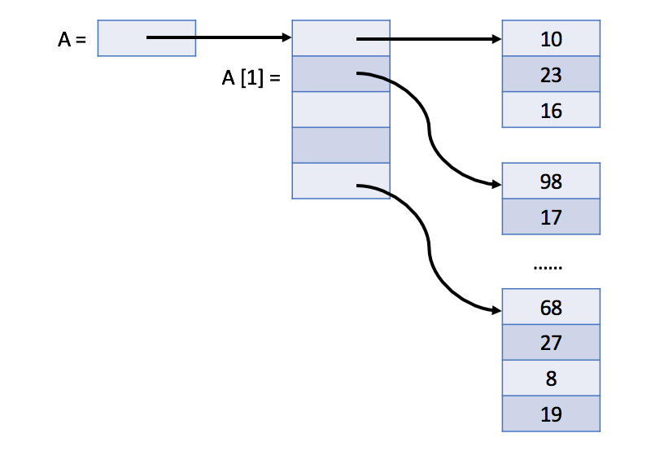
Introduction to 2D Array

Slide 53
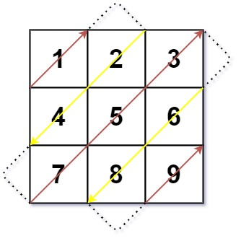
Diagonal Traverse
Given an m x n matrix mat, return an array of all the elements of the array in a diagonal order.
Example 1:
Input: mat = [[1,2,3],[4,5,6],[7,8,9]]
Output: [1,2,4,7,5,3,6,8,9]
Example 2:
Input: mat = [[1,2],[3,4]]
Output: [1,2,3,4]

Slide 54
Diagonal Traverse
Constraints:
m == mat.length
n == mat[i].length
1 <= m, n <= 104
1 <= m * n <= 104
-105 <= mat[i][j] <= 105

Slide 55
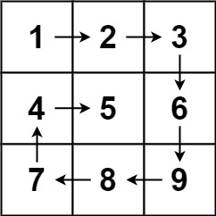
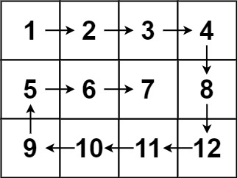
Spiral Matrix
Given an m x n matrix, return all elements of the matrix in spiral order.
Input: matrix = [[1,2,3],[4,5,6],[7,8,9]]
Output: [1,2,3,6,9,8,7,4,5]
Input: matrix = [[1,2,3,4],[5,6,7,8],[9,10,11,12]]
Output: [1,2,3,4,8,12,11,10,9,5,6,7]

Slide 56
Spiral Matrix
Constraints:
m == matrix.length
n == matrix[i].length
1 <= m, n <= 10
-100 <= matrix[i][j] <= 100

Slide 57
Pascal's Triangle
Given an integer numRows, return the first numRows of Pascal's triangle.
In Pascal's triangle, each number is the sum of the two numbers directly above it as shown:

Slide 58
Pascal's Triangle
Example 1:
Input: numRows = 5
Output: [[1],[1,1],[1,2,1],[1,3,3,1],[1,4,6,4,1]]
Example 2:
Input: numRows = 1
Output: [[1]]
Constraints:
1 <= numRows <= 30

Slide 59
Wrap-up

Slide 60
Topic Summary
✓ Performance optimization is the process of modifying a system to amplify its functionality, thus making it more efficient and effective. ✓ Code optimization strategies: ▪ Reduce time consumption ▪ Reduce space consumption ✓ We need to combine different strategies and techniques to improve code performance.

Slide 61
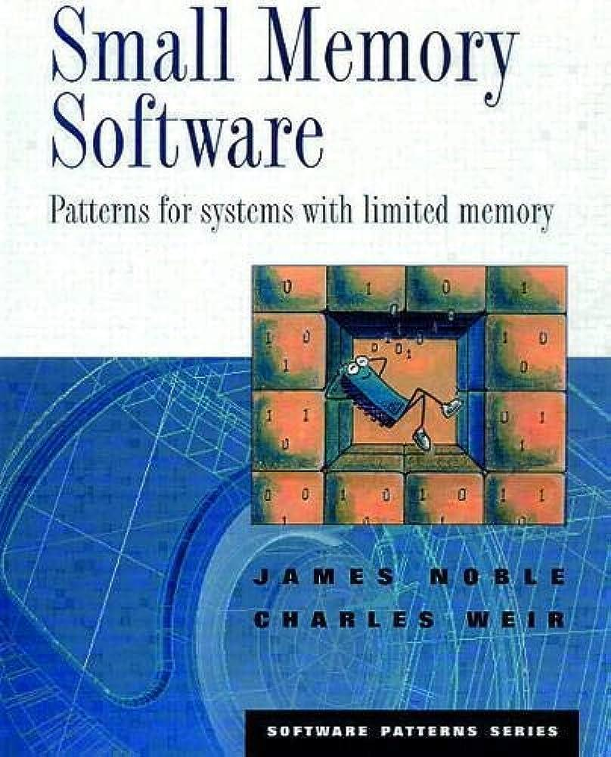
References
▪ https://www.gatevidyalay.com/code-optimization-techniques/

Slide 62
THANK YOU!

